Slide 1
Lower motor neuron circuits and motor control
By: Nicole Phillips

Slide 2
Learning objectives
Describe the general organization and functional properties of the motor system.
Explain the functional anatomy of reflexes, and how they are important in normal motor output.
Identify the signs of LMN damage and the anatomical basis of these signs.

Slide 3

Movement
Spatial and temporal patters of muscle contractions orchestrated by neural circuits

Slide 4
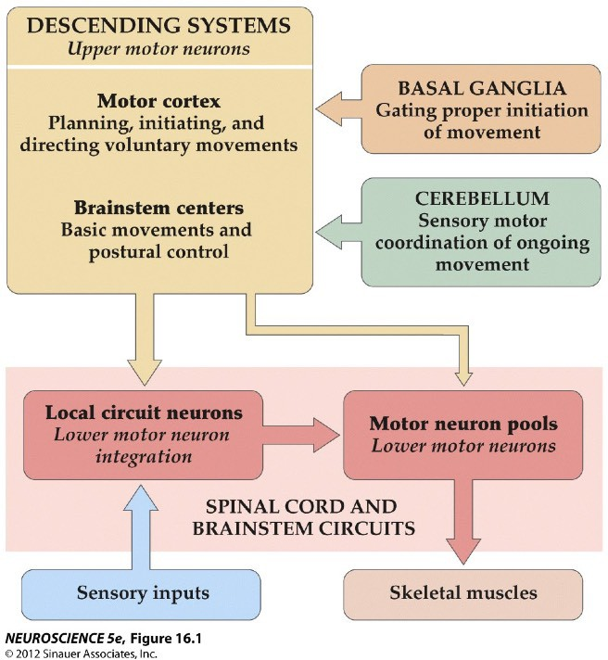
Four Neural Centers for Movement
3
Upper Motor Neurons (UMNs)
Top-down control of movement
2
Modulation of motor plans
4
1
Lower motor neurons (LMNs)
“Final common path” for initiating movement

Slide 5
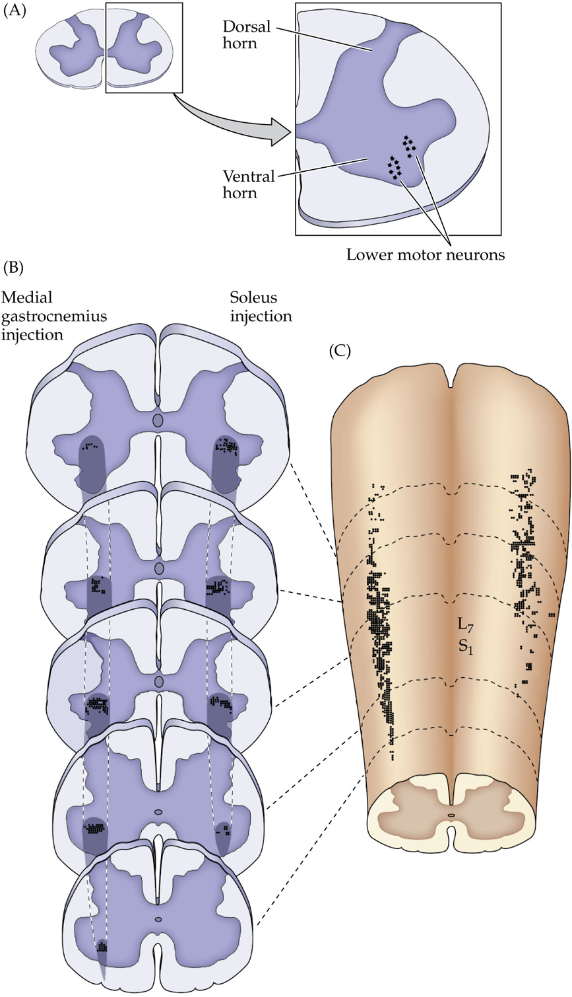
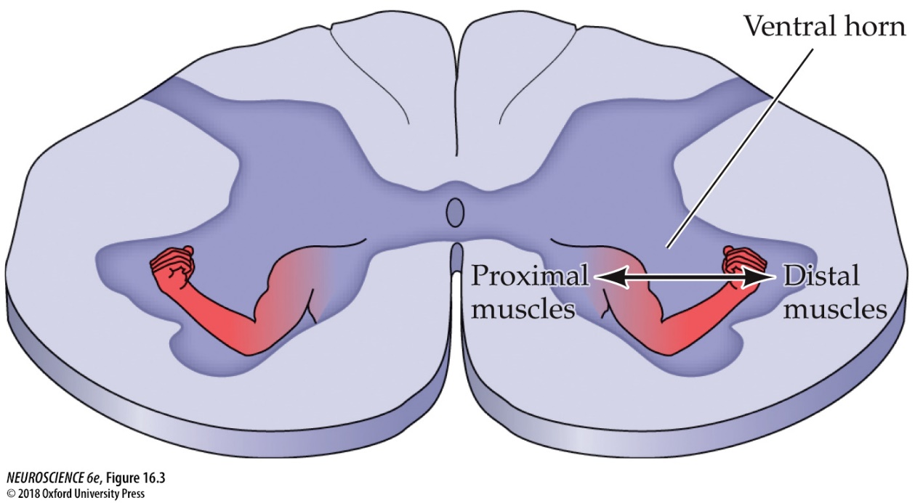
Motor Neuron-Muscle Relationship
Each LMN innervates muscle fibers of a single muscle(e.g bicep)
  Groups of LMNs that innervate the same muscle are referred to as the motor neuron pool for that muscle.
    Motor neuron pools have a somatotopic organization in the ventral horn.
Two types of LMNs exit the ventral root:
  α motor neurons (large)→ innervate the striated muscle fibers needed for posture and movement .
  γ motor neurons (small)→ specialized fibers that innervate muscle spindles.

Slide 6
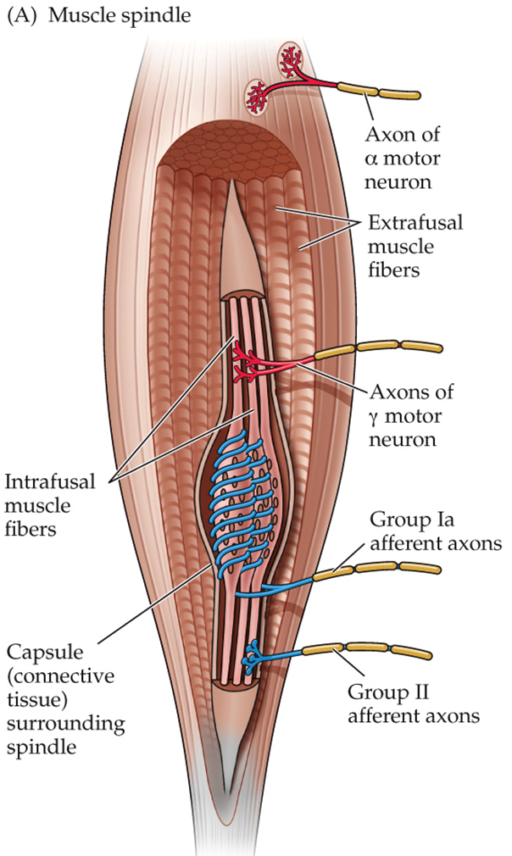
Fiber Types in the Motor System
Type | Class | Diameter | Myelin | Motor Fiber Types
α | Aα | 13 – 20 μm | Yes | Extrafusal fibers
γ | Aγ | 5 – 8 μm | Yes | Intrafusal fibers
Type | Class | Diameter | Myelin | Sensory Fiber Types
Ia | Aα | 13 – 20 μm | Yes | Primary receptors of muscle spindle
Ib | Aα | 13 – 20 μm | Yes | Golgi Tendon Organ
II | Aβ | 6 – 12 μm | Yes | Cutaneous mechanoreceptors, secondary receptors of muscle spindle, some nociceptors
Sensory feedback is used to execute accurate, guided movements

Slide 7
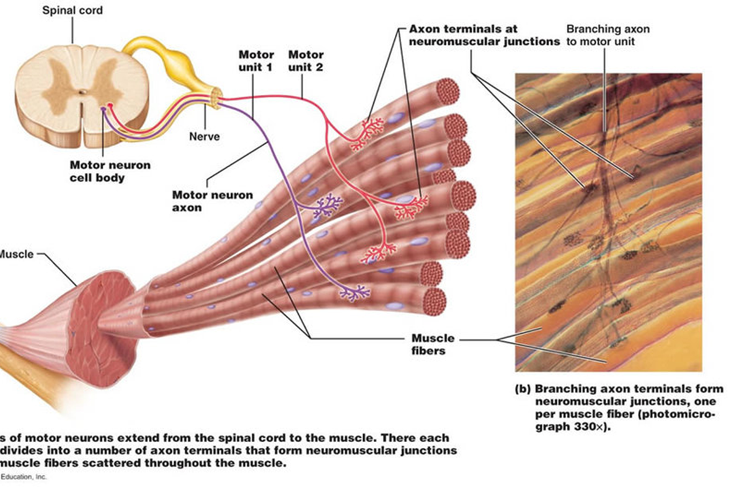
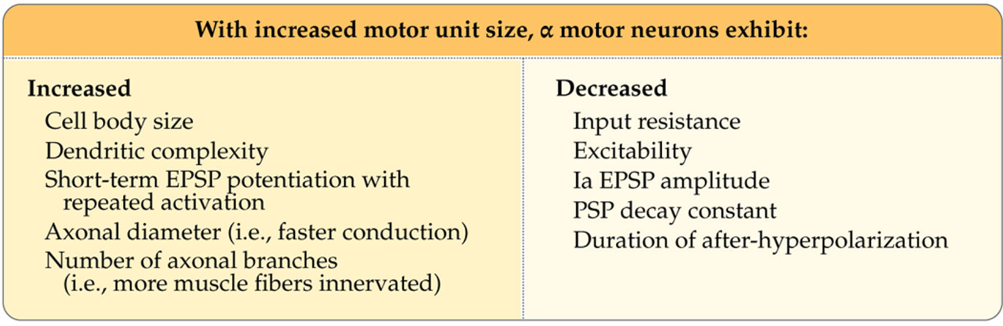
Motor Units
Motor unit: a single α-motor neuron and all the muscle fibers it synapses with.
When the neuron fires, all muscle fibers are stimulated and contract.
Motor units tend to have high innervation ratios in large muscles and low innervation ratios in smaller muscles involved in fine movements.
As the size of a motor unit increases, morphological and biophysical properties of α-motor neurons change.
Notes:
https://app.jove.com/embed/player?id=10871&t=1&s=1&fpv=1

Slide 8
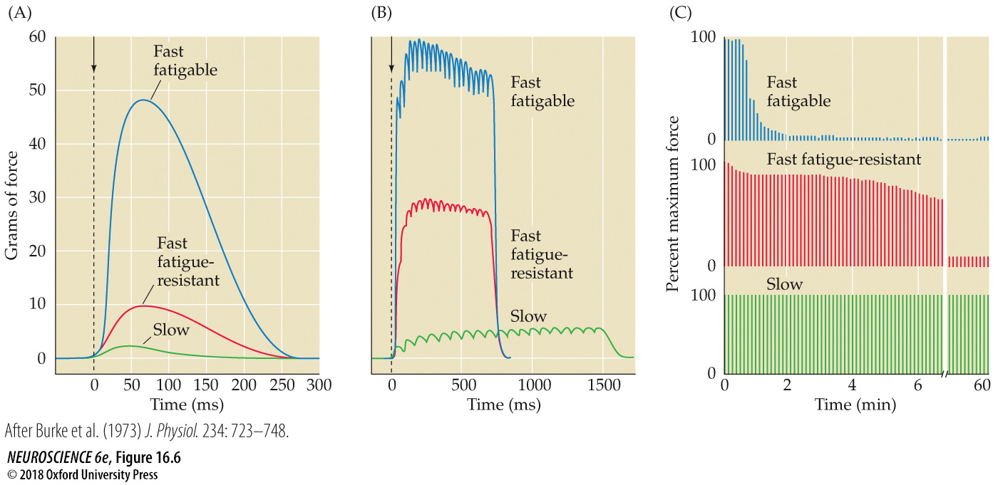
3 Broad Motor Unit Categories
Slow (S) → Type I
  Small units
  Contract slowly with relatively small force (e.g., posture)
  Resistant to fatigue
Fast fatigable (FF) → Type IIB
  Larger units
  Brief exertion, large force (e.g., running)
Fast fatigue-resistant (FR) → Type IIA
  In between properties and intermediate size
  Fatigue slower than FF, but sustain less time than S.
Single action potential
Repeated stimulation

Slide 9
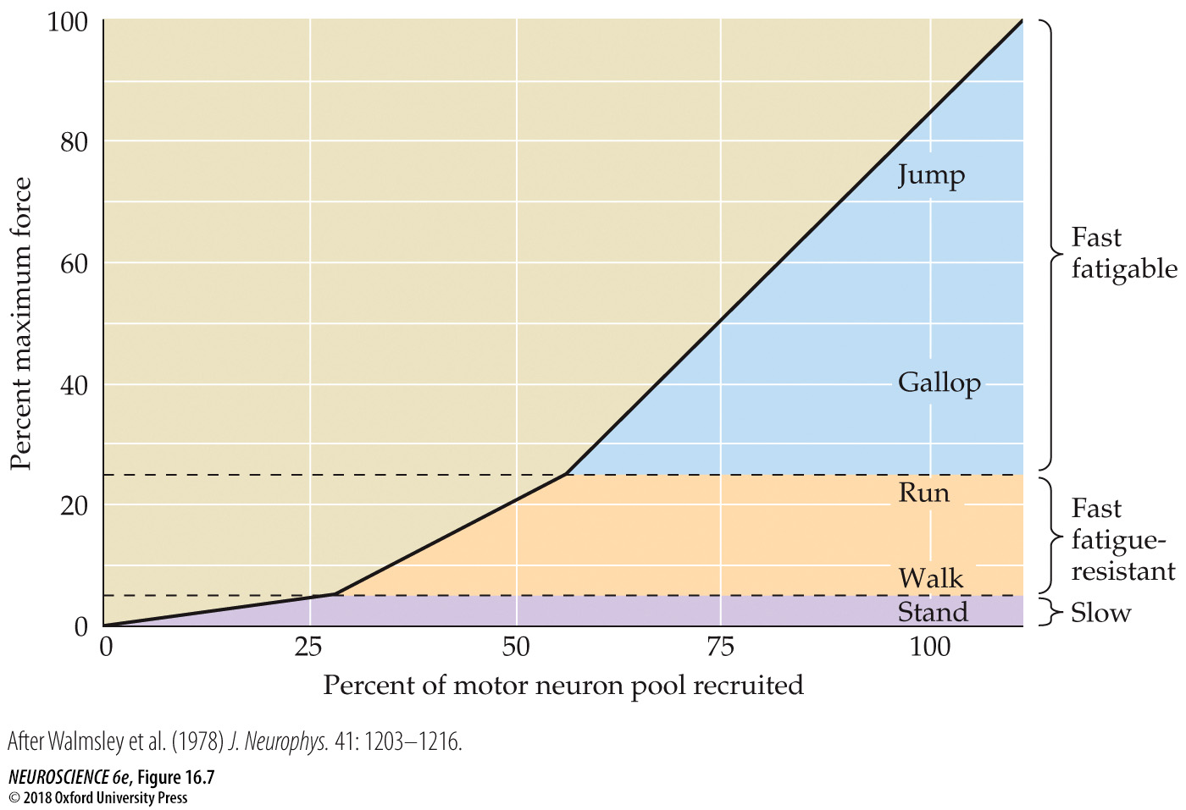
Size Principal
The orderly recruitment of motor neurons by size to generate increasing amounts of muscle tension:
S → FR → FF

Slide 10

Size Principle Explained

Slide 11
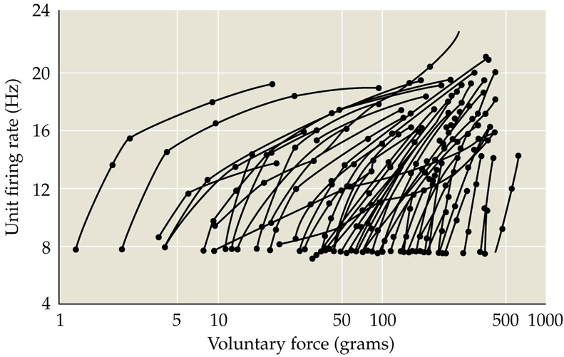
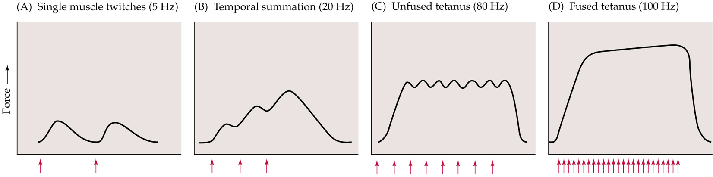
Firing Rate of LMNs Also Contributes to Muscle Tension
As voluntary force increases, LMN firing rate increases.
  Due to temporal summation of successive muscle contractions

Slide 12
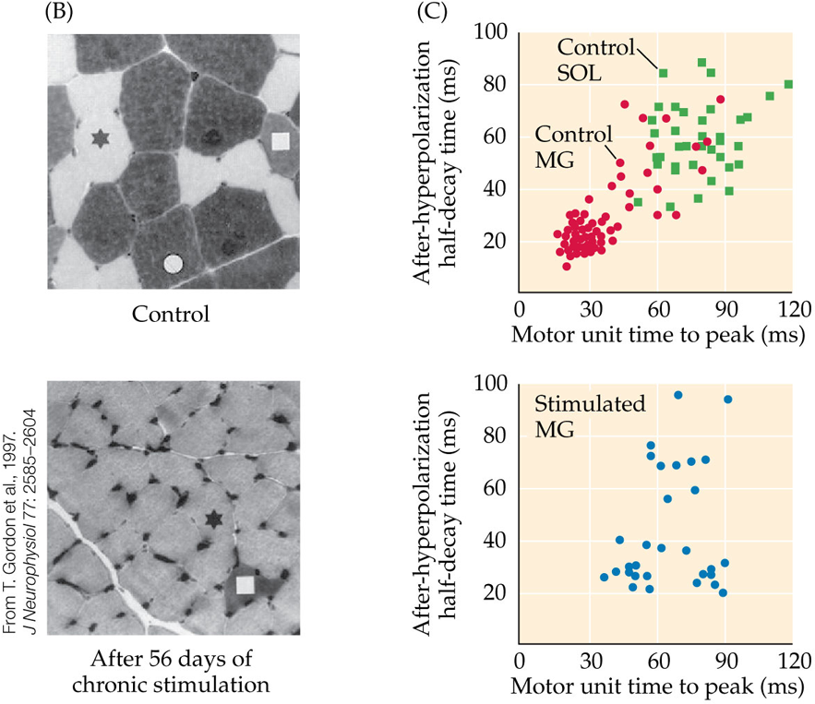
Are motor units subject to use-dependent plasticity?
Eccles & colleagues demonstrated that properties of slow and fast muscle fibers could be reversed when the innervation to these fibers was surgically switched (cross-innervation)
  Similar findings from studies of resistance and endurance training.

